Slide 1
Paper Nine: English Phonetics and Linguistics
Sound Unit-I: Syllable
by
Dr. Prithiviraj Singh Chauhan

Slide 2
What is syllable?
“A unit of pronunciation having one vowel sound, with or without surrounding consonants, forming the whole or a part of a word; for example, there are two syllables in water and three in inferno”
https://www.lexico.com/definition/syllable
“A syllable is a part of a word that contains a single vowel sound and that is pronounced as a unit. So, for example, ' book' has one syllable, and ' reading' has two syllables.”
https://www.collinsdictionary.com/dictionary/english/syllable

Slide 3
.
A syllable is a single, unbroken sound of a spoken (or written) word. Syllables usually contain a vowel and accompanying consonants. Sometimes syllables are referred to as the ‘beats’ of spoken language.
Syllables differ from phonemes in that a phoneme is the smallest unit of sound; the number of syllables in a word is unrelated to the number of phonemes it contains. For example: /b/, /k/, /t/, /ch/, /sh/, /ee/, /ai/, /igh/, /ear/ are all phonemes. The word ‘chat’ is made up of three phonemes (/ch/ /a/ /t/). The word ‘light’ is made up of three phonemes (/l/ /igh/ /t/). However, both the words ‘chat’ and ‘light’ have only one syllable each.
Source: https://www.theschoolrun.com/what-is-a-syllable

Slide 4
Syllable formation:
The vowel in syllable is its central element and is called the nucleus of syllable
The consonant that begins that begins a syllable is called the releasing consonant and one that comes at the end of syllable is called the arresting consonant
Symbols used to describe these sounds are:
Vowel- V, Consonat-C
Example: Kat- CVC

Slide 5
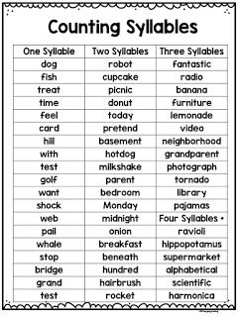
Examples:
Words with only nucleus sound:
I /ai/, eye /ai/ ah! /a:/
Mono (single) syllabic words:
Dog /dɒɡ/, time /tʌɪm/,
want/wɒnt/, test /tɛst/, bridge
/brɪdʒ/
PC: https://in.pinterest.com/pin/94927504626051071/

Slide 6
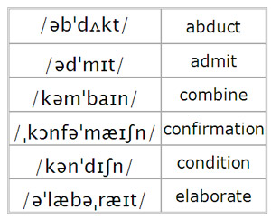
Examples;
Disyllabic words:
PC:http://www.azlifa.com/pp-lecture-8/

Slide 7
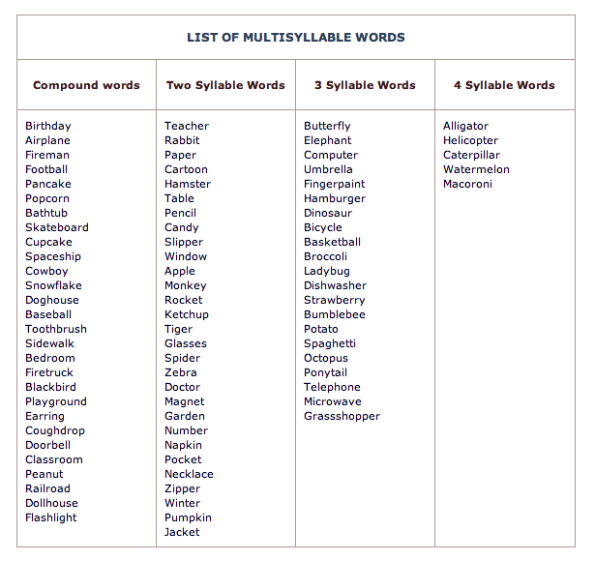
PC:https://in.pinterest.com/pin/70087337927372565/

Slide 8
.
For more information and practice visit:http://www.grammarinenglish.com/syllabification/?lesson=trisyllabic_words
Reference
Balasubramanian, T. (2002) A Text Book of English Phonetics for Indian Students. New Delhi: Macmillan India. Rpt.

